Slide 1
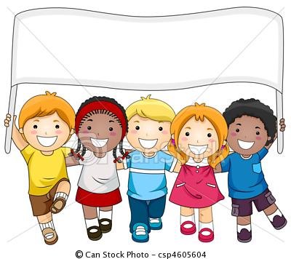
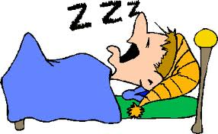



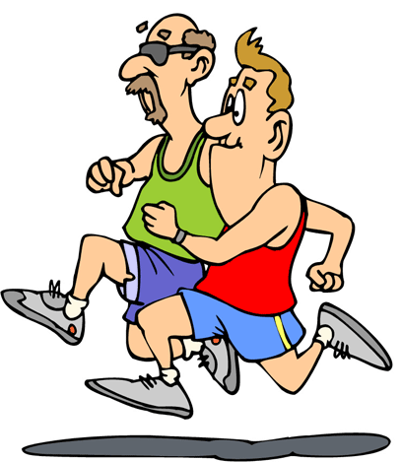

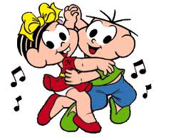
Saturday
Monday
Sunday
Tuesday
1 2 3 4 5 6 7 8 9 10 11 12 13 14 15 16 17 18 19 20 21 22 23 24 25 26 27 28 29 30 31
Wednesday
Thursday
Friday

